Slide 1


Effects of the COVID-19 Pandemic on the Economic and Psychological Well-Being of Hourly Service Workers and their Families
Anna Gassman-Pines, Duke University
PAA Congressional Briefing
April 23, 2021

Slide 2
Ongoing daily survey
Sample Characteristics
 |  | St.
 | Mean | Dev.
Race/ethnicity (%):
African-American (non-Hispanic) | 49.5%
White (non-Hispanic) | 18.2%
Asian (non-Hispanic) | 3.3%
Multi-racial (non-Hispanic) | 2.3%
Hispanic (of any race) | 22.5%
Age | 31.0 | 7.0
Female (%) | 83.1%
Education (%):
Less than a high school education | 26.3%
Exactly a high school education | 44.3%
Monthly household income | $2,239 | $1,672
Child characteristics
Age | 4.9 | 2.6
Female (%) | 50.0%
Sample of ~1,000 hourly service workers with young children in Philadelphia, recruited in late summer-fall, 2019
Originally focused on work schedule unpredictability and worker and family well-being

Slide 3
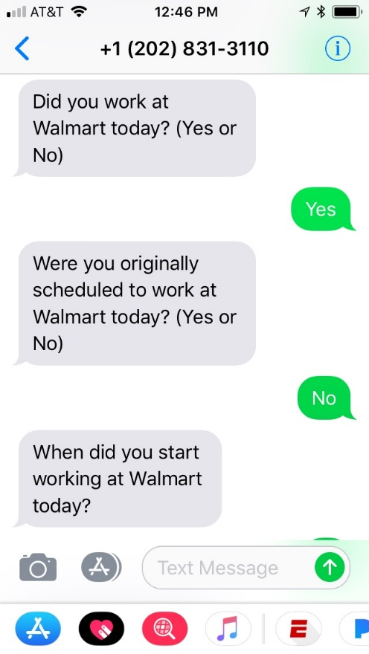
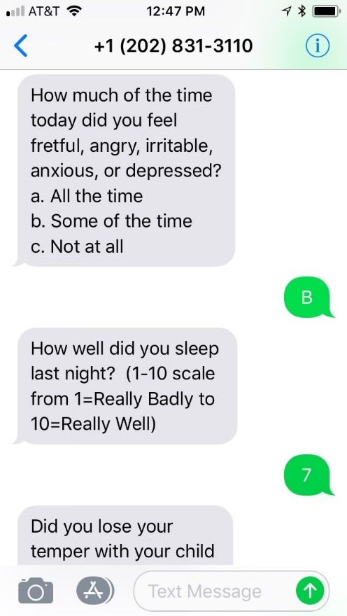
Ongoing daily survey
Ask them about their work and home experiences and well-being via basic SMS text message every day for 2 weeks
By mid-March, had ~700 re-enrolled

Slide 4
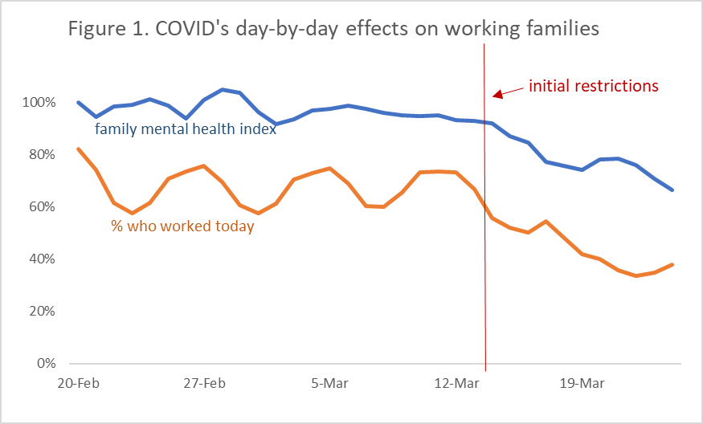
Immediate declines in work and family well-being once COVID-19 restrictions put in place

Slide 5
When pandemic began, we pivoted to ask about it…
Collected data throughout 2020
  1st survey: Mid-March to late April (now published in Pediatrics*)
    High levels of job and income loss, caregiving burden, material hardship
    Alarming levels of psychological distress
  2nd survey: May-June
  3rd survey: September-November
  *Gassman-Pines, A., Ananat, E. O., & Fitz-Henley II, J. (2020). COVID-19 and parent-child psychological well-being. Pediatrics, 146(4).

Slide 6
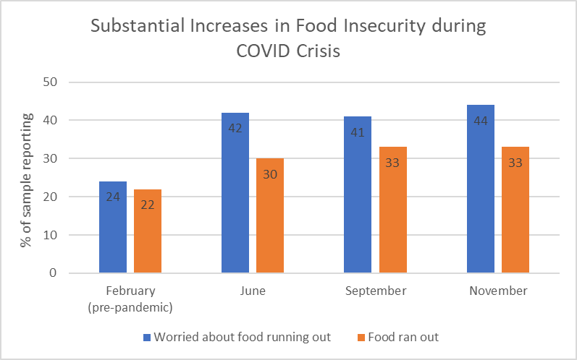

Slide 11
Pandemic benefits did not reach everyone:
UI is an illustrative example
Of the workers who were laid off, 87% tried to apply for UI—others said they thought they weren’t eligible (8%), or that it seemed too difficult (5%)
Of those who tried to apply, 95% got through the process
Of those who successfully applied, 62% received UI
Of those who received UI, 84% had PUC included in their check

Slide 12
Pandemic benefits did not reach everyone
Of the workers who were laid off, 87% tried to apply for UI—others said they thought they weren’t eligible (8%), or that it seemed too difficult (5%)
Lower among Hispanic respondents, who perceive they are ineligible
Of those who tried to apply, 95% got through the process
Of those who successfully applied, 62% received UI
Of those who received UI, 84% had PUC included in their check

Slide 13
Pandemic benefits did not reach everyone
Of the workers who were laid off, 87% tried to apply for UI—others said they thought they weren’t eligible (8%), or that it seemed too difficult (5%)
Of those who tried to apply, 95% got through the process
Lower among Black respondents, whose benefits were less likely to arrive
Of those who successfully applied, 62% received UI
Of those who received UI, 84% had PUC included in their check

Slide 14
Chronic mental health struggles
In Fall 2020, nearly half of the parents screened positive for depression, anxiety or both
17% of parents report that children are sad or worried the majority of the time
Chaotic schooling/care situations in first half of school year may be a significant driver

Slide 17
Implications
Continued supports for working families and the schools and child care facilities they use are needed
Work/income
December extension of expanded pandemic unemployment compensation an important first step
Additional stimulus rolling out now will help even more
More attention to ensuring that all families – especially families of color – receive benefits
Mental health and other supports
Strengthen systems addressing family mental health and invest in additional family supports
Look for additional ways to aid schools and child care centers

Slide 18
Conclusions
The effects of the COVID crisis on hourly service workers with young children on work, income, and well-being were immediate and striking
Effects on families have persisted as pandemic persisted
Policies aimed at providing income to families during the crisis helped but their reach has not been universal
Little attention has been paid to family mental health needs
Additional public supports will help families in need

Slide 19

Funding for this work provided by:
Eunice Kennedy Shriver National Institute of Child Health and Human Development, National Institutes of Health (#1R21HD100893-01)
National Science Foundation (# SES-1921190)
Russell Sage Foundation (#1811-10382)
Washington Center for Equitable Growth
Thank you!
agassman.pines@duke.edu

